Slide 1
Cloud Project
Using TERRAFORM as a source

Slide 2
Introduction to terraform
Terraform is a tool for building, changing, and versioning infrastructure safely and efficiently.
It takes your infrastructure you have defined in code and makes it real.
The code that you have to write to configure Terraform is different from normal code in languages such as Java or C#.
The beauty of what Terraform does is that it does not ask you how to get from the infrastructure you have to the infrastructure you want.
It just asks you what you want the world to look like and then it does the hard work

Slide 3
Deploying Infrastructure
Terraform supports multiple providers. We have to specify the provider details for which we want to launch the infrastructure for.
With the provider, we also have to add the tokens which will be used for authentication.
On adding a provider, terraform init will download plugins associated with the provider.
terraform apply : After you run the apply you will see quite a lot of output from Terraform. You will notice that the apply has paused and is awaiting a response from you.

Slide 4
AWS Access & Secret Keys
Terraform Uses the Access keys to login to our environment and create the infrastructure.
The sample example for creating the code is :
provider "aws" {
region = "us-west-2"
access_key = “Access key"
secret_key = “Secret Key"
}
resource "aws_instance" "myec2" {
ami = "ami-0528a5175983e7f28"
instance_type = "t2.micro"
}

Slide 5
Overview of Resources
Resources are the reference to the individual services which the provider has to offer.
Example:
resource aws_instance
resource aws_alb
resource iam_user
resource aws_vpc

Slide 6
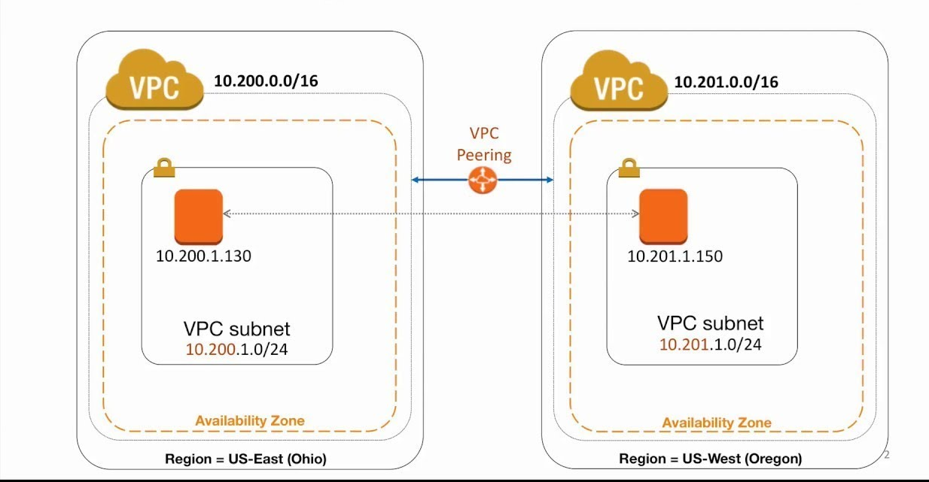
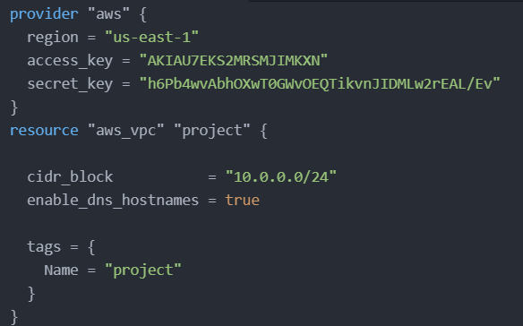
VPC
Virtual Private Cloud ( VPC) enables you to launch AWS resources into a virtual network that you've defined.
The following are the key concepts for VPCs:
Subnet
Route table
Internet gateway
CIDR block
Note : When you create a VPC, you must specify a range of IPv4 addresses for the VPC in the form of a Classless Inter-Domain Routing (CIDR) block; for example, 10.0.0.0/16. This is the primary CIDR block for your VPC.

Slide 7
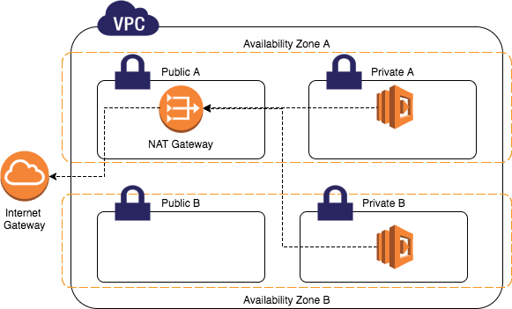
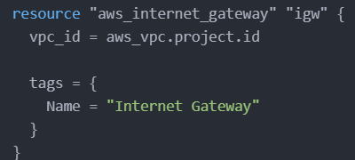
Internet Gateway
A router is required for any network that needs access to the Internet. Such a device is known as an Internet gateway because it serves as a “gateway” to the Internet.
your Internet gateway connects your private network to your ISP’s network
You must still take steps to prevent an intruder from sneaking into your network through your Internet gateway.
your Internet gateway router or your DNS server address changes, you have to manually update each computer on the network.

Slide 8
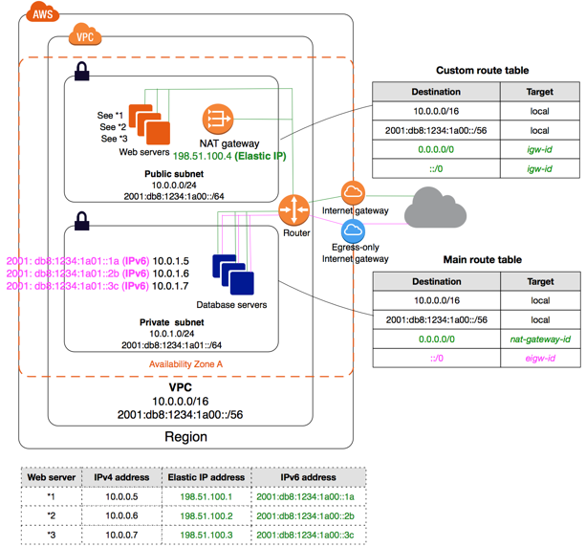
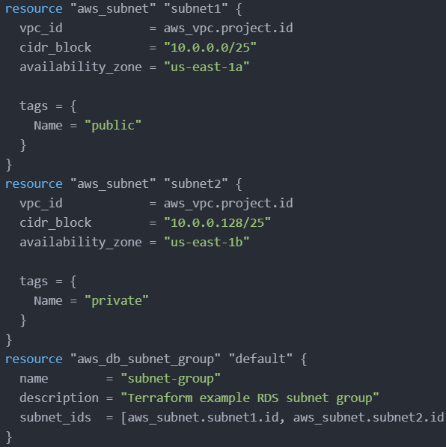
Subnets
There are two types of subnets public subnet and private subnet.
Public subnet : A public subnet is a subnet that's associated with a route table that has a route to an Internet gateway. An Internet gateway. This connects the VPC to the Internet and to other AWS services. Instances with private IPv4 addresses in subnet range.
Private Subnet : Instances in the private subnet are back-end servers that don't need to accept incoming traffic from the Internet and therefore do not have public IP addresses; however, they can send requests to the Internet using the NAT gateway

Slide 9
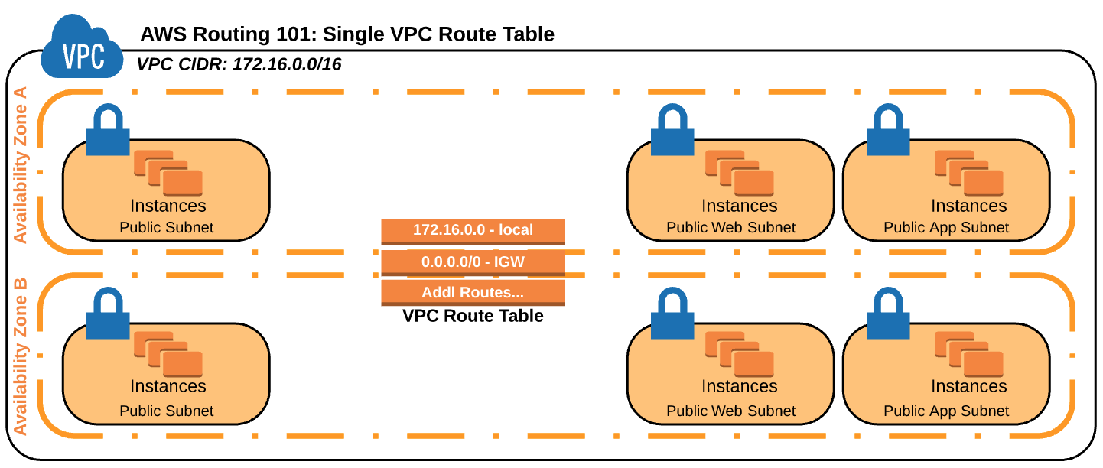
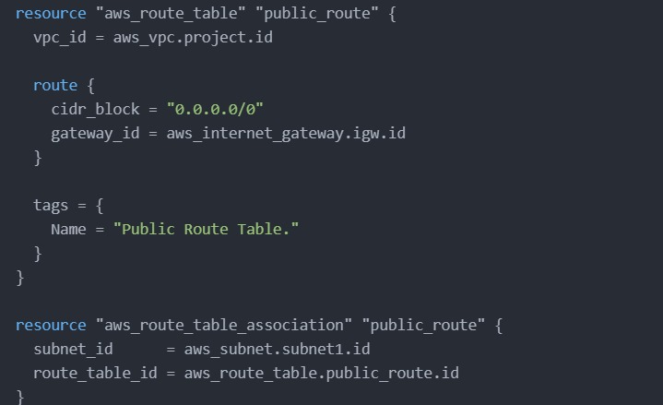
Route Table
For a typical computer that has a single network interface and is connected to a local area network (LAN) that has a router, the routing table is pretty simple and isn’t often the source of network problems.
For each entry in the routing table, five items of information are listed:
The destination IP address Actually, this is the address of the destination subnet, and must be interpreted in the context of the subnet mask.
The subnet mask that must be applied to the destination address to determine the destination subnet.
The IP address of the gateway to which traffic intended for the destination subnet will be sent.
The IP address of the interface through which the traffic will be sent to the destination subnet.
The metric, which indicates the number of hops required to reach destinations via the gateway.

Slide 10
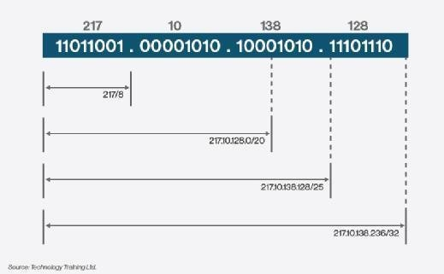
CIDR
Addresses in IP version 4 (IPv4), the current version, are 32 bits long and are divided into two parts, a network portion and a host portion. The boundary is set administratively at each node, and in fact can vary within a site. (The older notion of fixed boundaries between the two address portions has been abandoned, and has been replaced by Classless Inter-Domain Routing (CIDR). A CIDR network address is written as follows: 207.99.106.128/25.
Class less Inter-Domain routing allows internet service providers to reduce wasting of IP address by assigning a company a subset of a network number instead of the entire network.
It also reduces the size of Internet routing tables allowing the internet to grow.

Slide 11
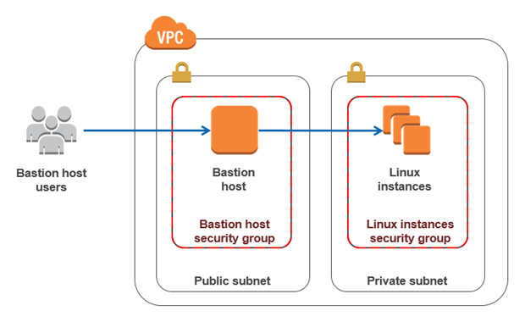
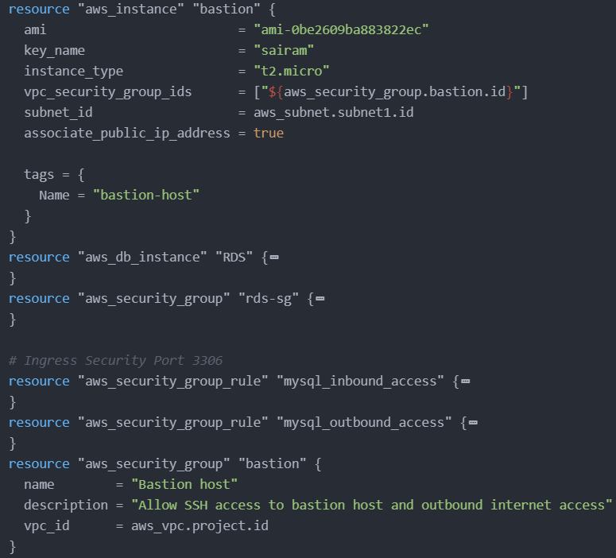
Bastion Host
A bastion host is a special-purpose computer on a network specifically designed and configured to withstand attacks.
A bastion host is a server whose purpose is to provide access to a private network from an external network, such as the Internet. Because of its exposure to potential attack, a bastion host must minimize the chances of penetration
The bastion host hardware platform executes a secure version of its operating system, making it a trusted system. Only the services that the network administrator considers essential are installed on the bastion host.

Slide 12
END

